Slide 1
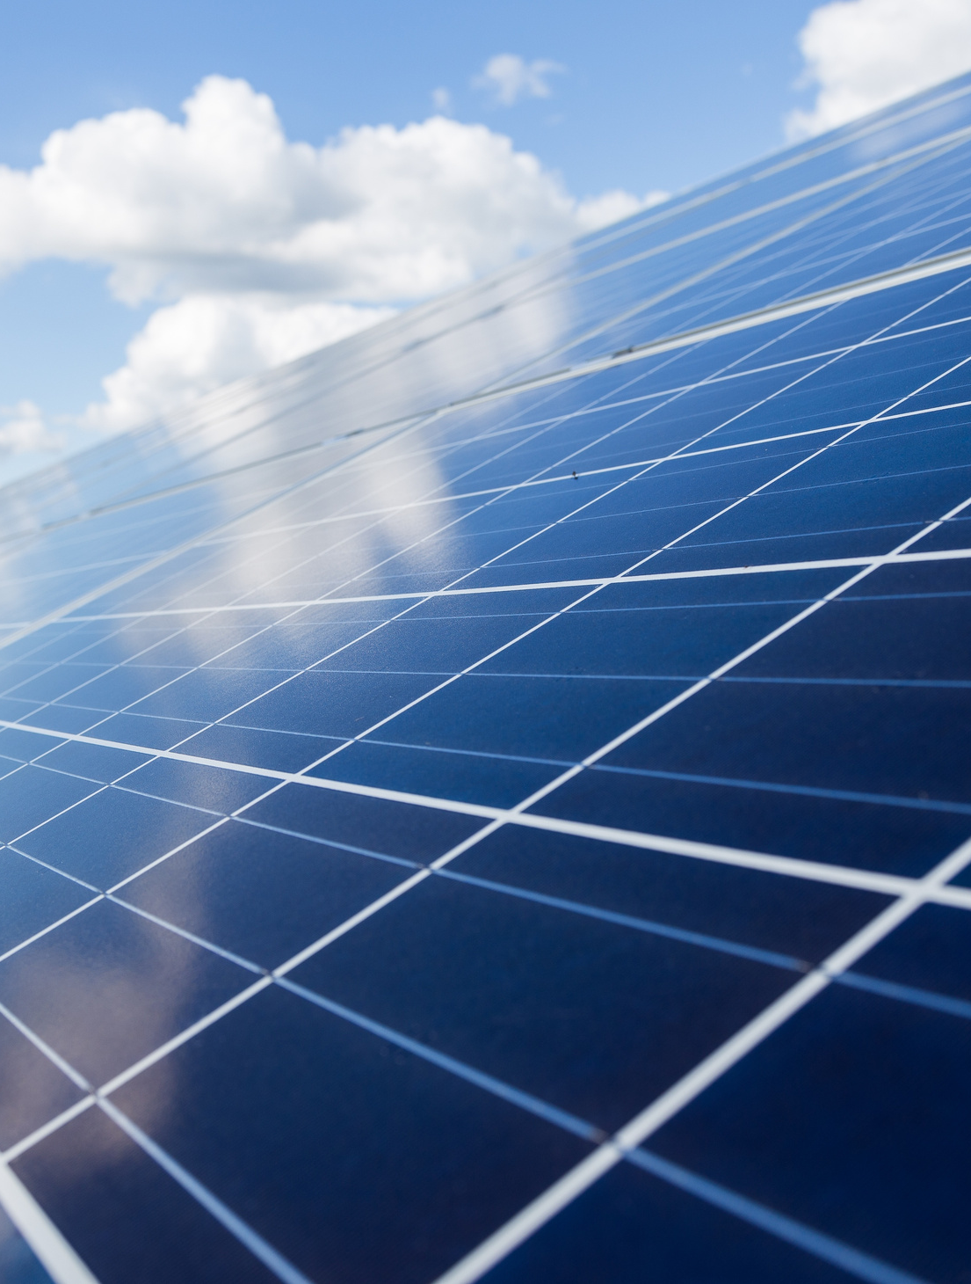
Save for solar
Alberto Stephen Dubin Hernandez 0244139
Heidi Meiners Muñoz 0266159
Natalia Trujillo Perez 0267484

Slide 2
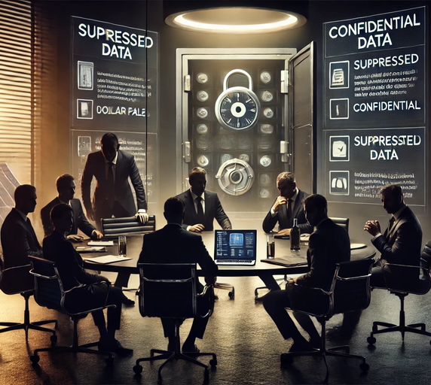
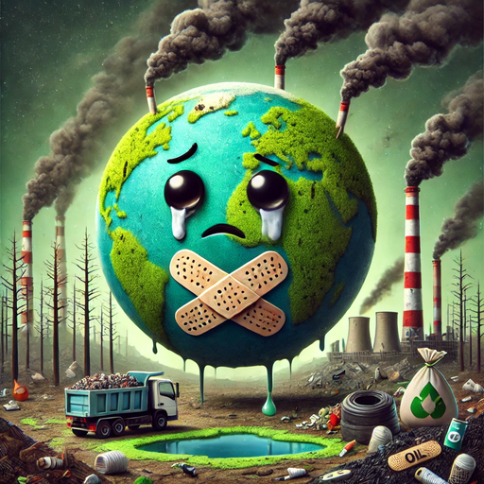
The big bad
Lack of information about solar energy.
Level of contamination of nonrenewable resources.
Big corporations gatekeeping information about the efficiency of solar energy.
How can we preserve natural resources?
Can you become truly independent?

Slide 3
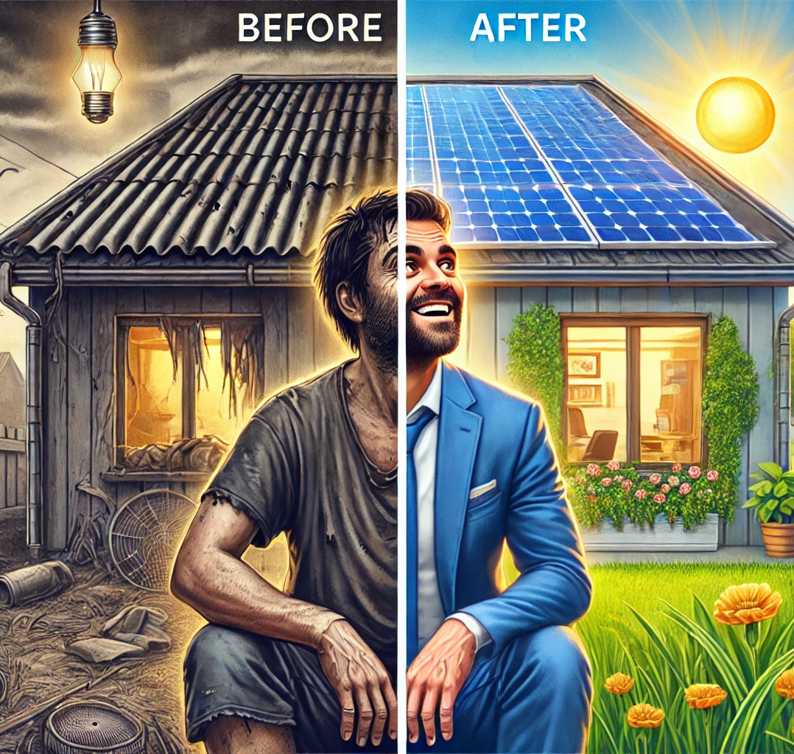

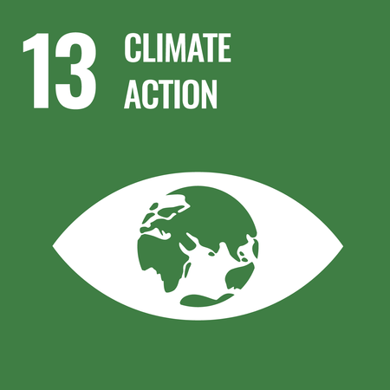
The solution
We aspire to educate others about the incredible benefits of switching to solar energy. But how can we achieve this? Simply by sharing valuable information: how solar energy supports the ecosystem, the various types of solar energy available, and even offering a calculator to estimate how many solar panels you'll need to cover your electricity bill.

Slide 4
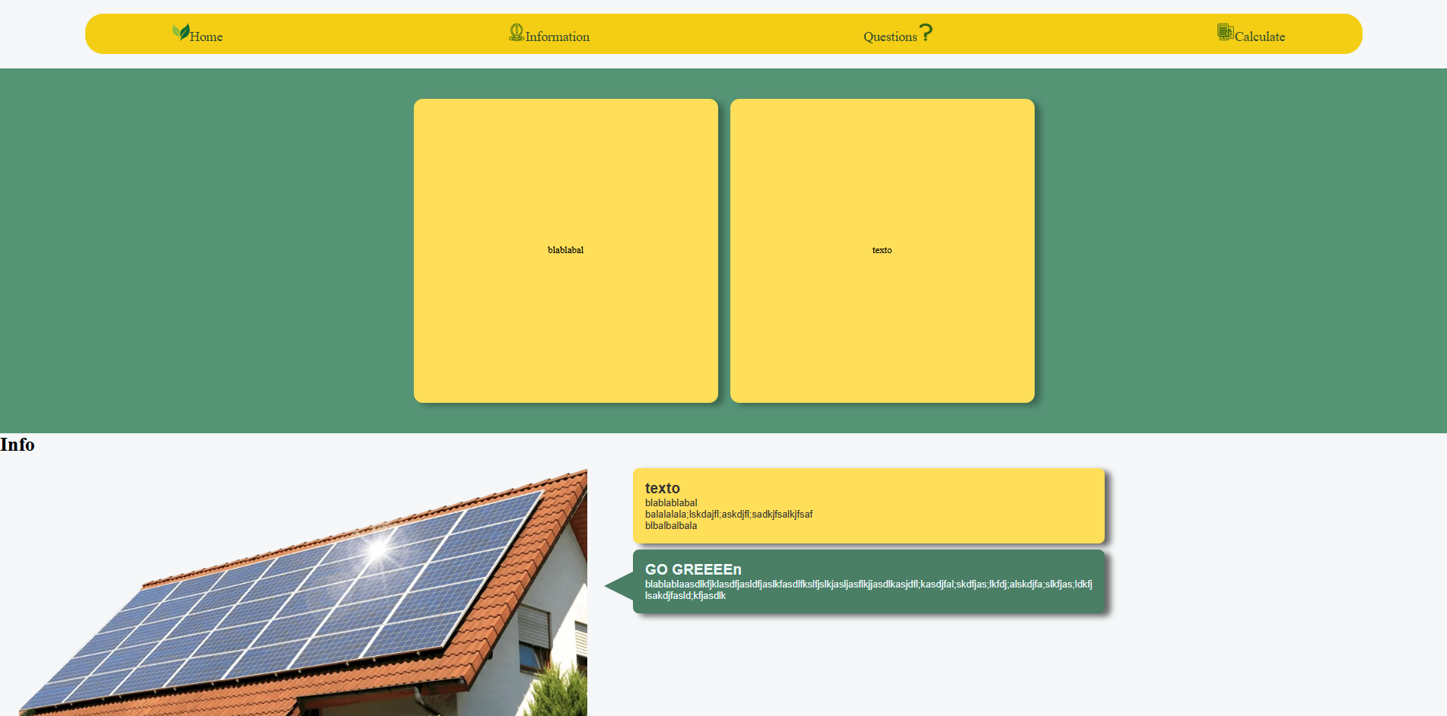
Prototype 1

Slide 5
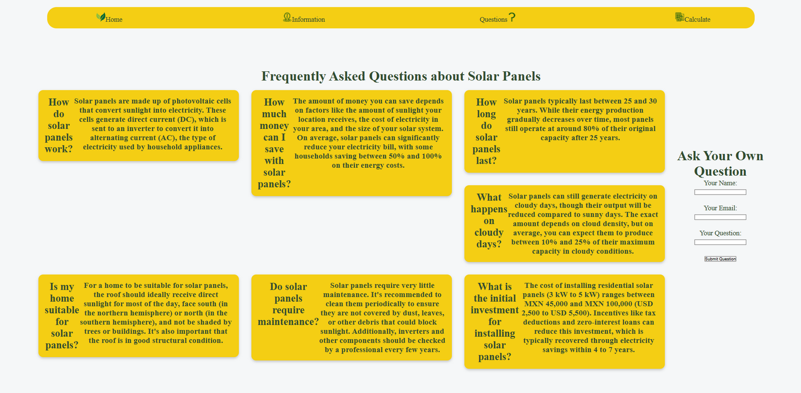
Prototype 1

Slide 6
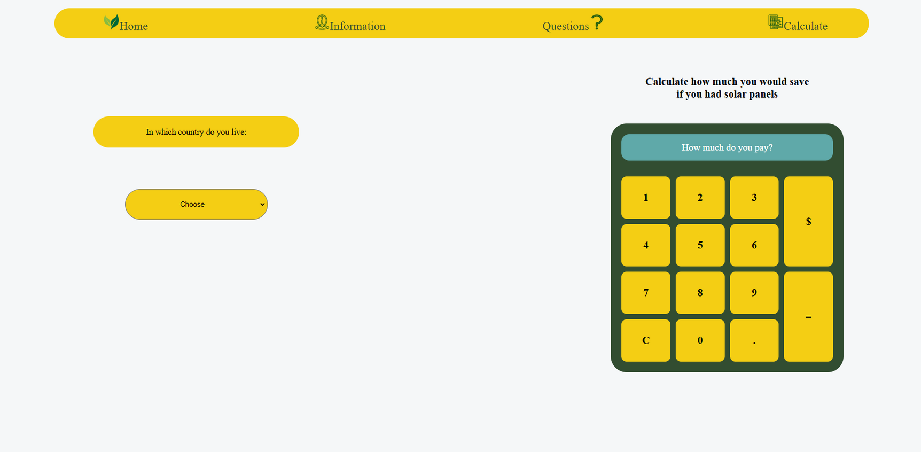
Prototype 1

Slide 7
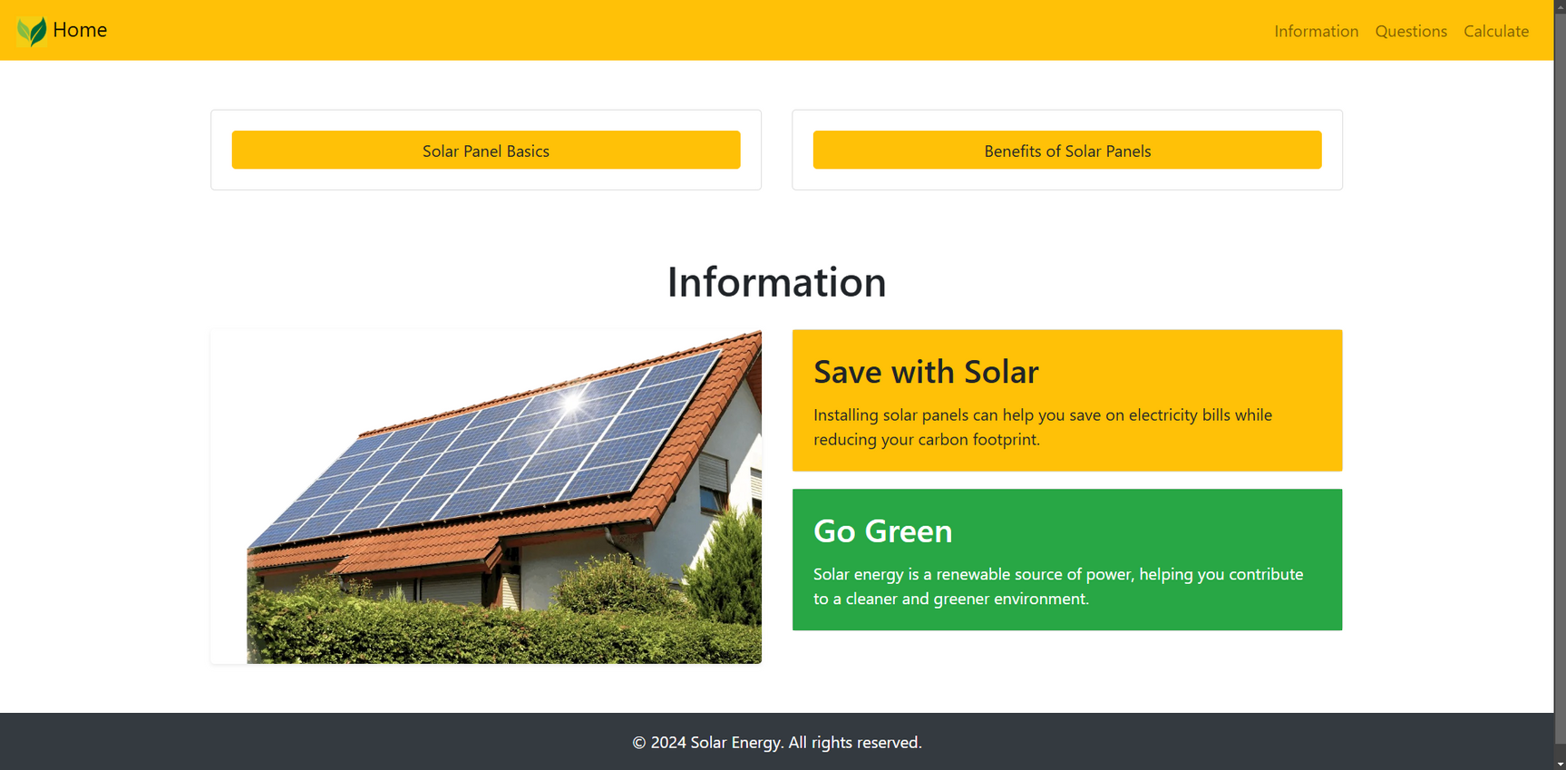
Prototype 2

Slide 8
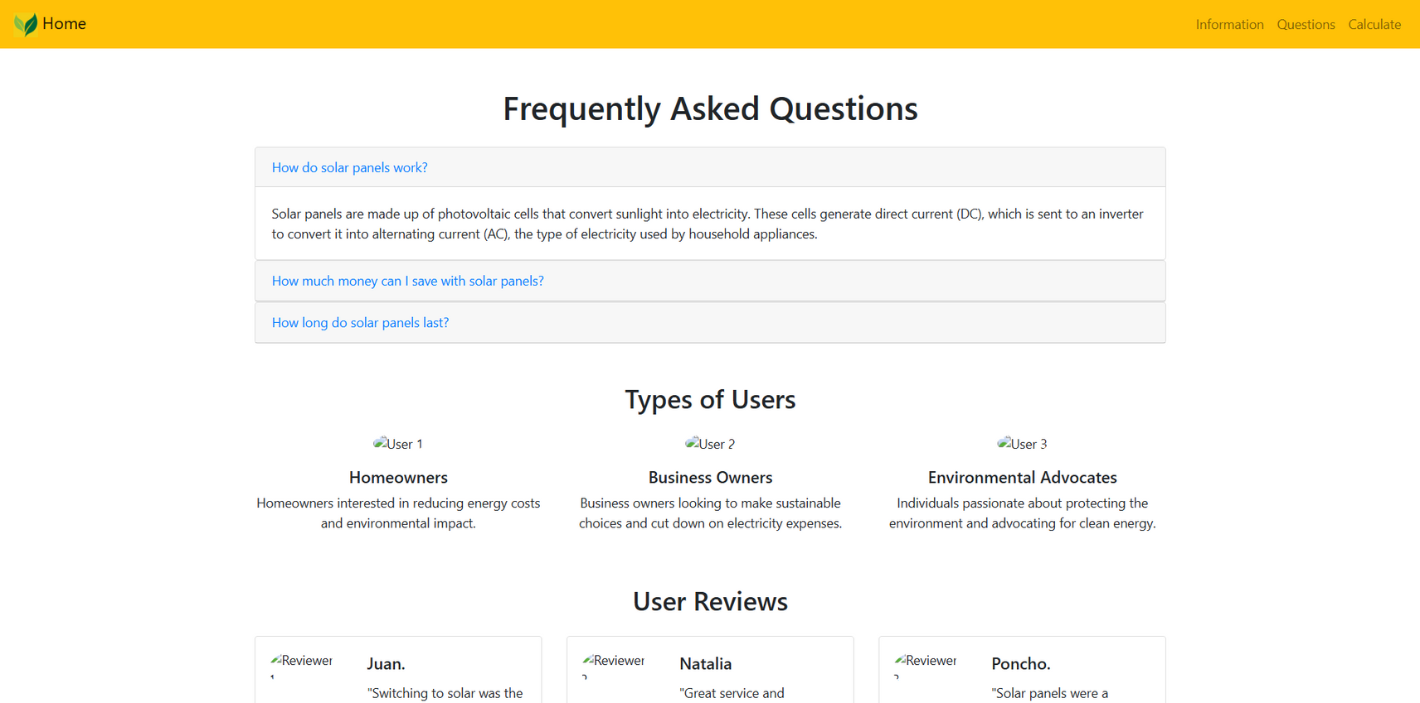
Prototype 2

Slide 9
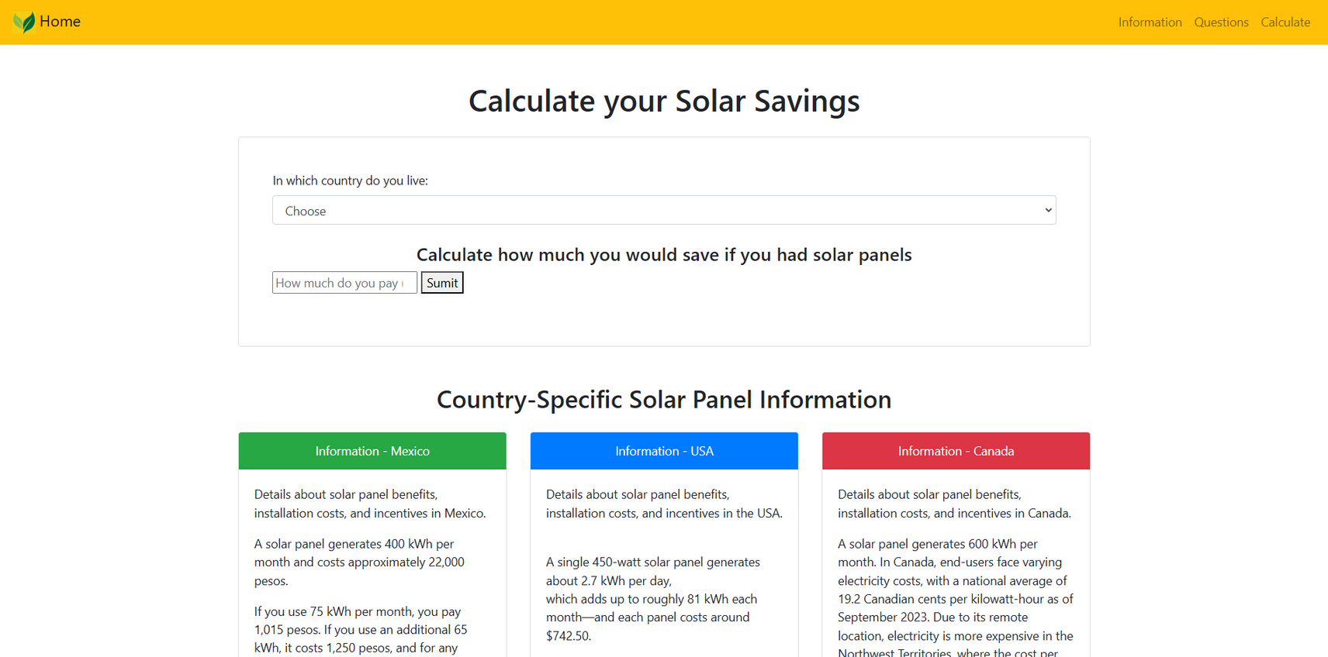
Prototype 2

Slide 10
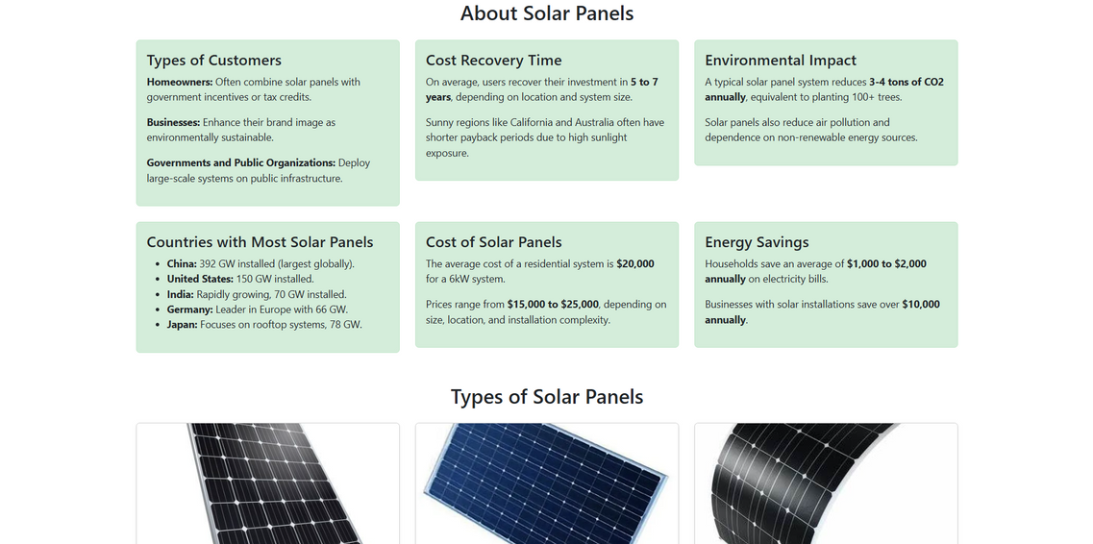
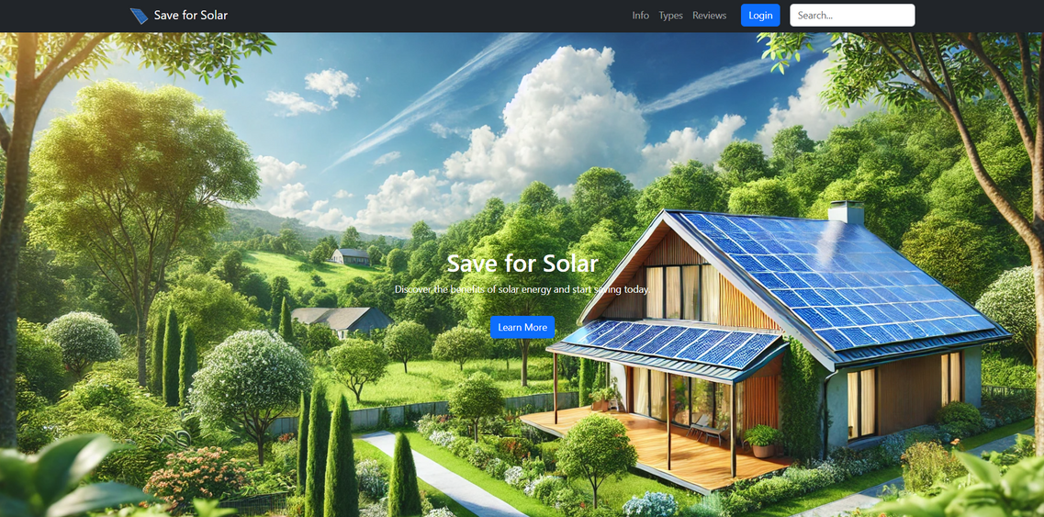
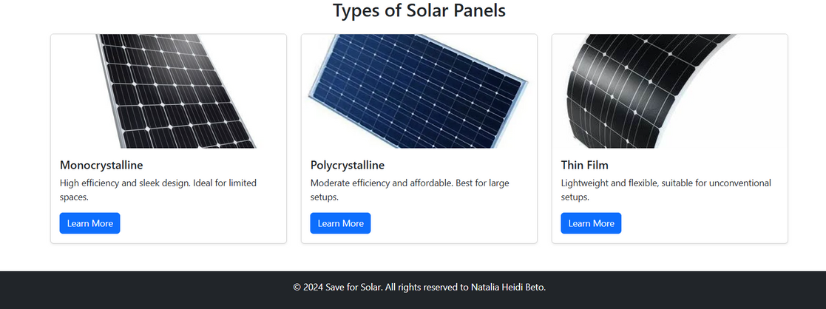
Final version

Slide 11
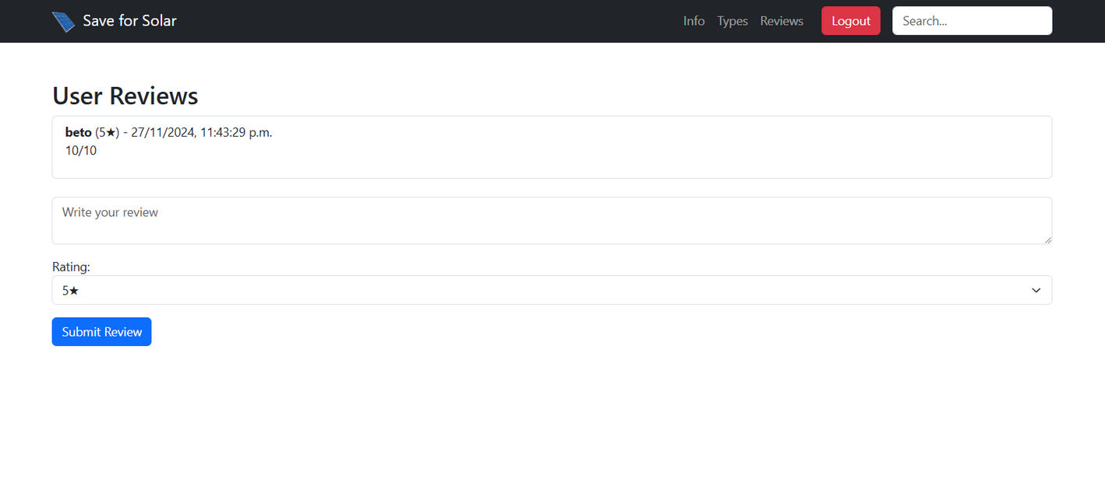
Final version

Slide 12
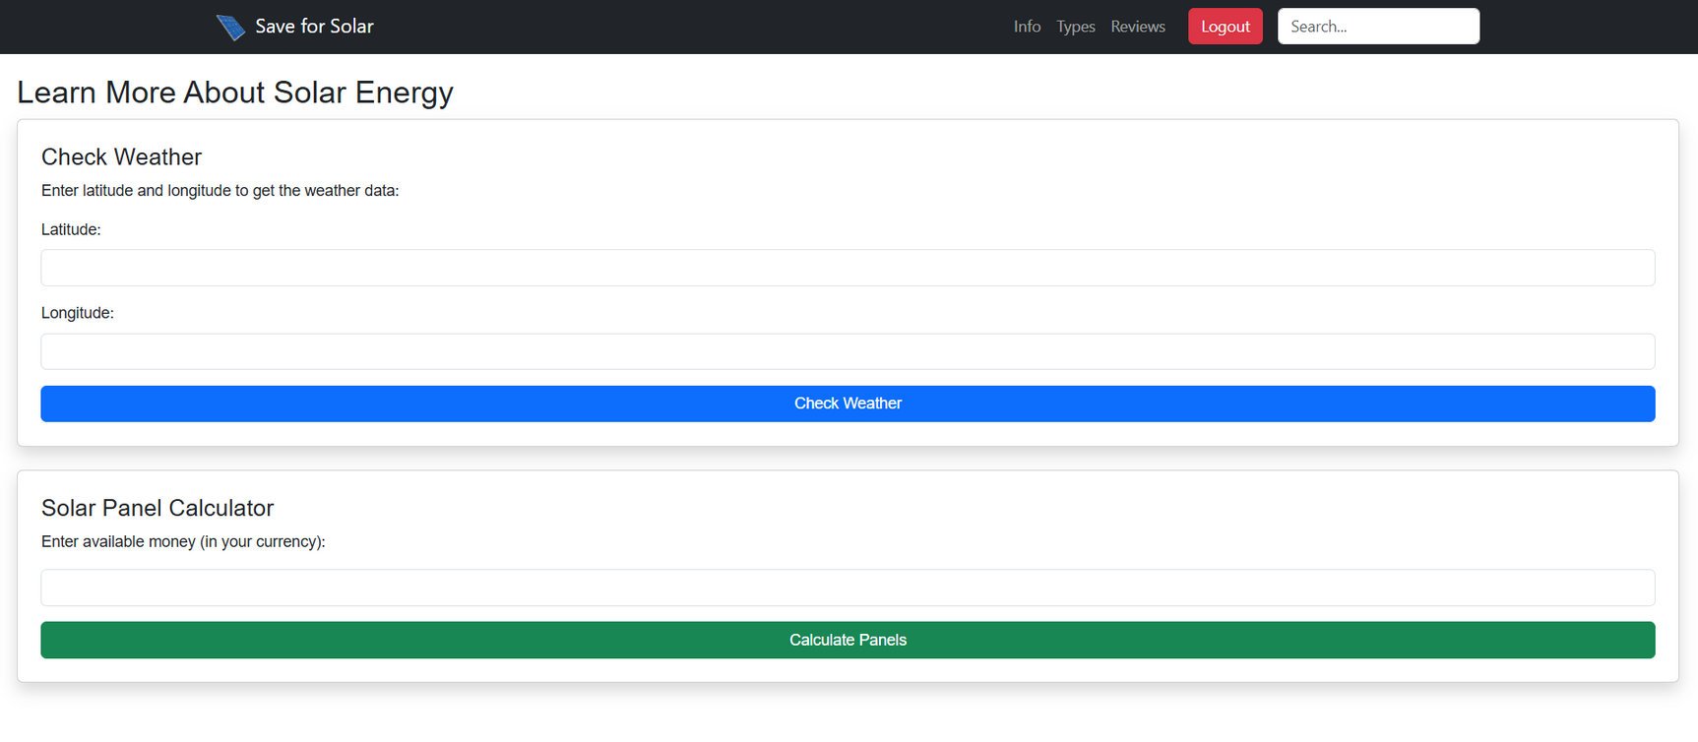
Final version

